Slide 1
Choosing best place to start Indian food business
Atlanta Vs Birmingham

Slide 2
SELECTION:
In this project I have selected two popular places in both areas and checks which area have more Indian food restaurants, using the data I am going to draw some conclusions of which place is better to start Indian food business.

Slide 3
DATA
For this project I did use the foursquare APIs to collect the data and drawn conclusions.
The information I gathered using foursquare is location data address, longitude, latitude, postal code, venue id and category.

Slide 4
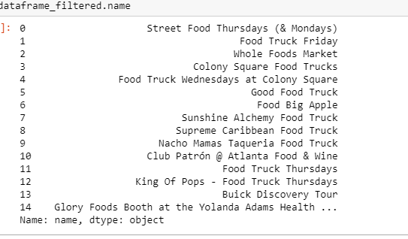
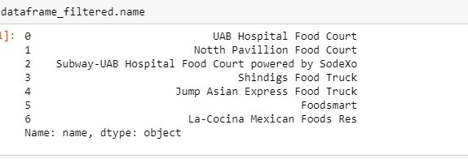
RESULTS PART A & PART B:

Slide 5
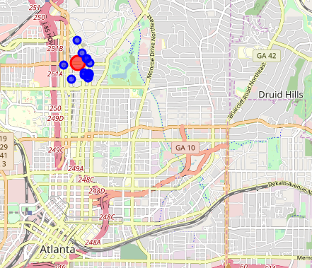
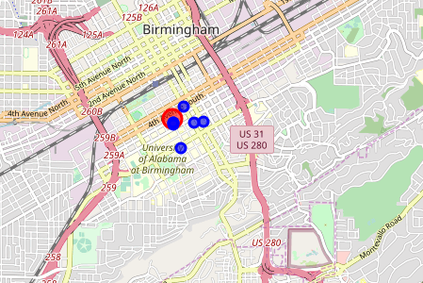
VISUALIZATIONS OF A & B

Slide 6
CONCLSUIONS:
As I suggest from the results, it is recommended to start the business in second place, because of very competition and both places equally popular.

